Slide 1
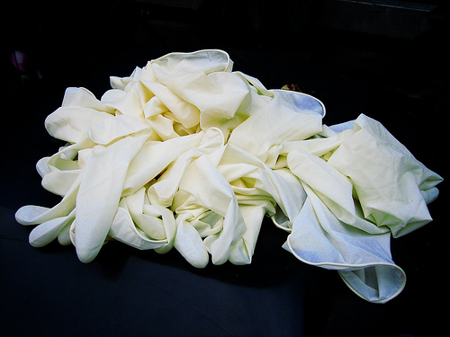
Welcome
Clean vs Sterile Wound Technique
Developing Evidence Based Guidelines of Care
PresenterVickiRoss

Slide 2
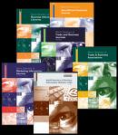
Clean VS Sterile Questions
Does uncertainty exist on technique?
Is there sufficient evidence?
What are the current practices?
How can one design a guideline?

Slide 3
Literature Review
Studies describe inconsistent practices
51% favored sterile, 43% clean, WOCN (1993)
No scientific foundation behind choices

Slide 4
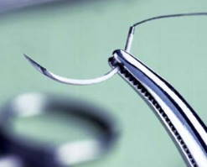
Current evidence
Perleman et al. (2004) ER suturing study
Lawson, Juliano, and Ratliff (2003) Open surgical wounds
“Stotts, et al. (1997) No significant effect on infection

Slide 5
Current Practices
Follow procedure in reference book, i.e. Mosby
Mosby (2006) … follow hospital policy!
WOCN Position Statement (2001)…Clean
for most
AACN Procedure Manual (2005)…Clean/
surgical grafts

Slide 6
GUIDELINES OF CARE KEY PLAYERS
Wound Healing Department
Infectious Disease Department
Surgical Steering Committee
Clinical Practice Committee
Nursing Education

Slide 7
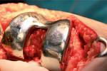
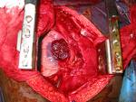
GUIDELINES OF CARE
SURGICAL WOUNDS
NOT APPROXIMATED WITH EXPOSED HARDWARE OR ORGANS
IMMUNOSUPRESSED/
PRIMARY CLOSURE
FIRST DRESSING CHANGE
STERILE TECHNIQUE
→
OR
USE

Slide 8
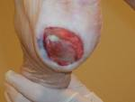
GUIDELINES OF CARE
NON SURGICAL
WOUNDS
IMMUNOSUPPRESSED
MD ORDER
NURSING JUDGEMENT
→
USE
STERILE TECHNIQUE

Slide 9
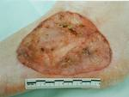
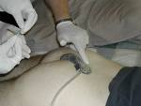
GUIDELINES OF CARE
Ulcerations
Traumatic wounds
Lacerations
Unapproximated
Surgical wounds
Miscellaneous
Clean Technique
USE

Slide 10
The End
THANK YOU

