Slide 1
(Dis)Connects
Writing Centers, Digital Natives and Digital Immigrants
Leigh Ryan, Writing Center Director

Slide 2
Face to Face
1.3 Million views on YouTube
5,000 blog links
Facebook: Unknown
University of Maryland College Park

Slide 3
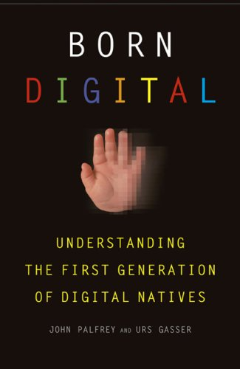
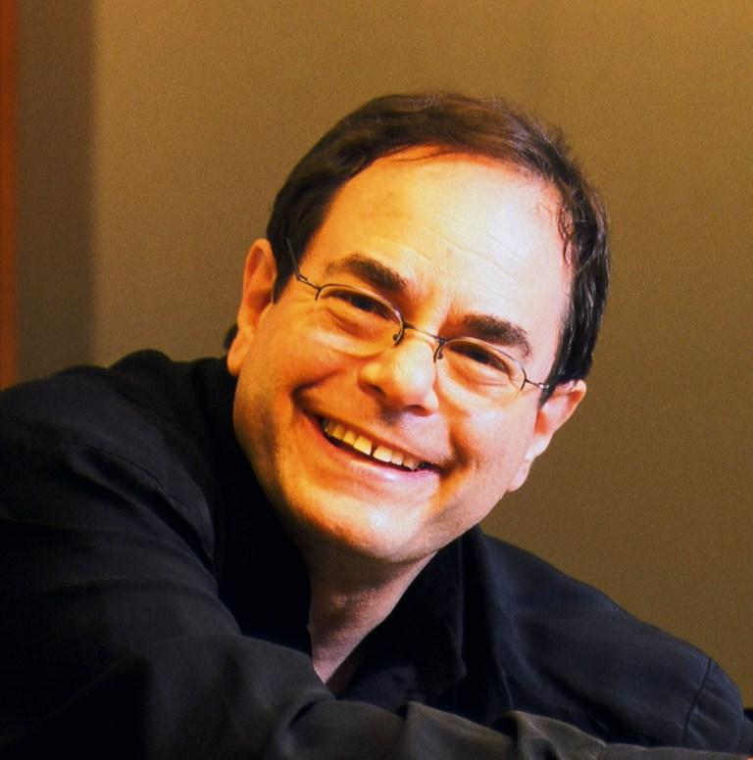
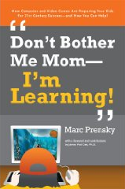
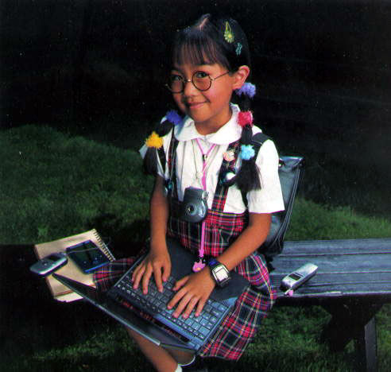
Natives & Immigrants
University of Maryland College Park

Slide 4
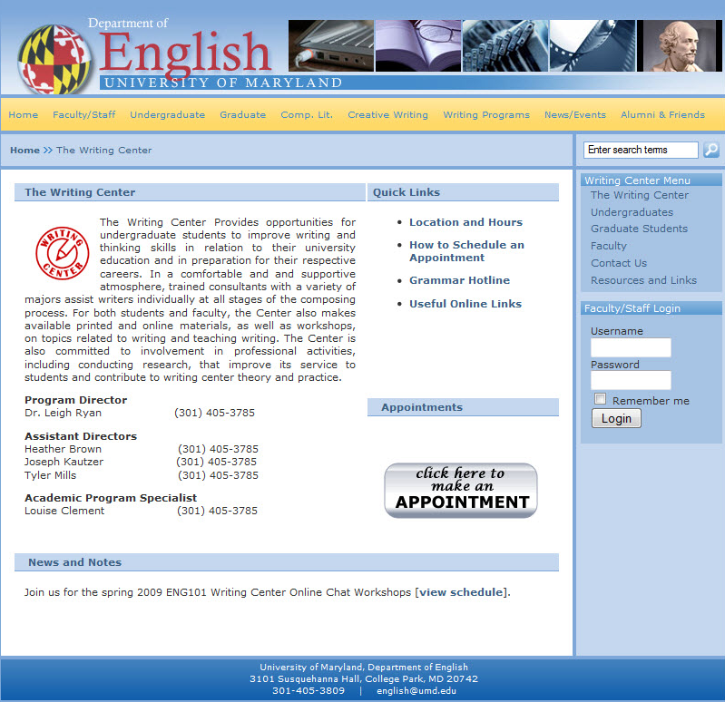
UMCP Writing Center
Face-to-face
Traditional undergrad, grad, ESL, adults
5 days & 3 evenings/week
55 tutors – undergrad, grad, community volunteers
Online registration, hotline, in-class workshops, chats
University of Maryland College Park

Slide 5
NCTE: 21st Century Literacies
Top 3 Abilities for Success
1. To seek information & critically evaluate sources (95%)
2. To read & interpret a variety of texts, print and online (94%)
3. To innovate & apply knowledge creatively (94%)
University of Maryland College Park

Slide 6
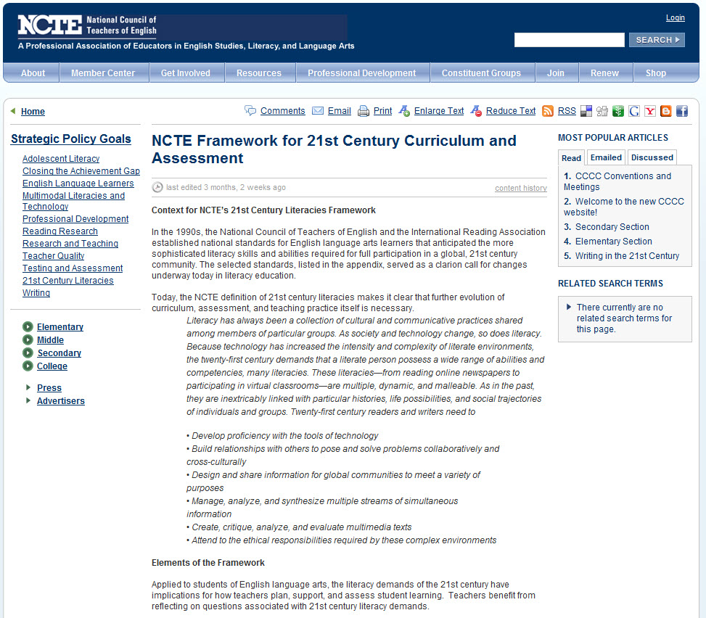
NCTE Framework 21st Century
Required Literacies
Multiple
Dynamic
Malleable
University of Maryland College Park

Slide 7
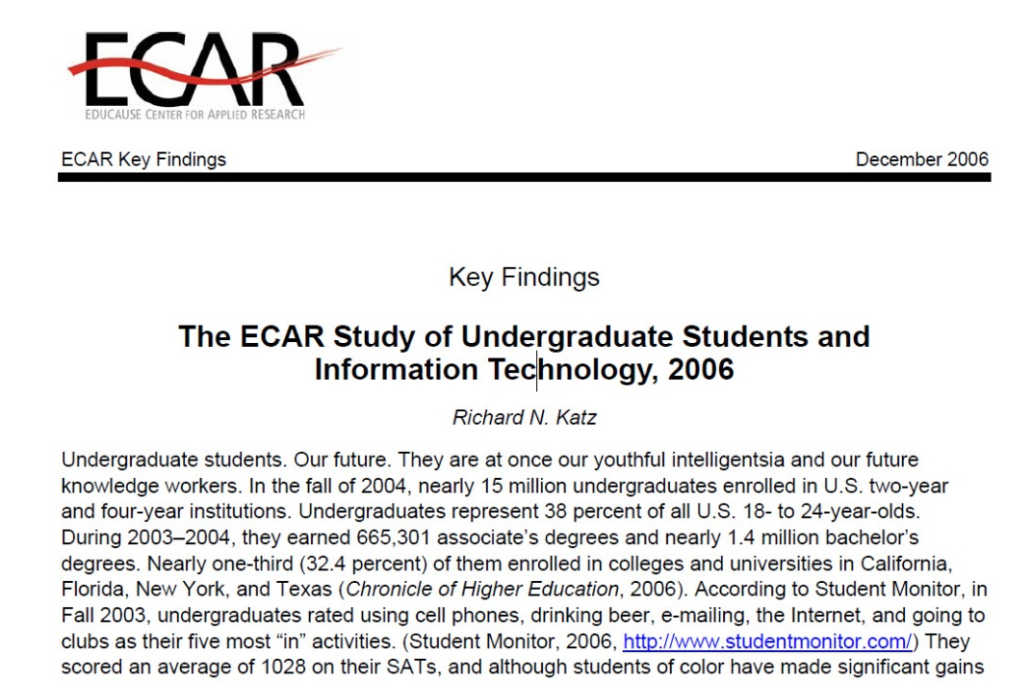
NCTE Framework 21st Century
Develop Proficiency with Technology
Create, read, and send emails | 99.9%
Create digital documents for school | 98.8
Search Web and institutional library | 94.0
Create digital presentations | 90.8
IM (most daily) | 80.0
Use course management systems | 75.0
play computer/video games | 73.4
Download video/music files | 70.6
Use social networks | 70.6
Create web pages | 28.6
Use video/audio editing software | 27.7
University of Maryland College Park

Slide 8
NCTE Framework 21st Century
Build Relationships to Pose & Solve Problems (Collaboratively, Cross-Culturally)
University of Maryland College Park

Slide 9
NCTE Framework 21st Century
Design & Share Information for Global Communities to Meet a Variety of Needs
University of Maryland College Park

Slide 10
NCTE Framework 21st Century
Manage, Analyze, Synthesize Multiple Streams of Simultaneous Information
University of Maryland College Park

Slide 11
NCTE Framework 21st Century
Attend to Ethical Responsibilities Required by These Complex Environments
University of Maryland College Park

Slide 12
Case Study
University of Maryland College Park

